Slide 1
GIT & GIT-HUB
BY
AKHIL M ANIL

Slide 2
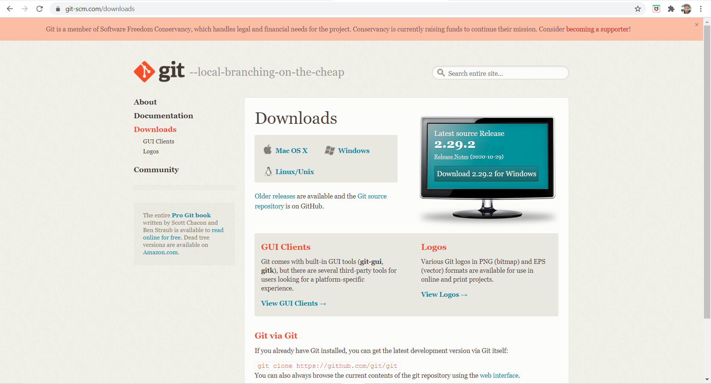
Download GIT

Slide 3
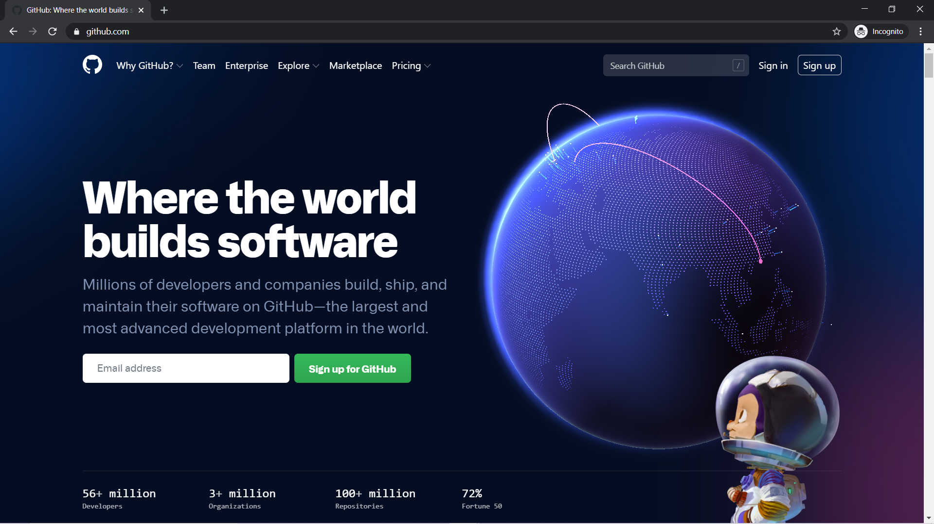
Go to github.com

Slide 4
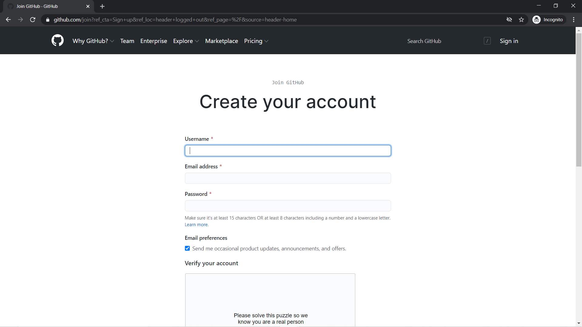
Github - Signup

Slide 5
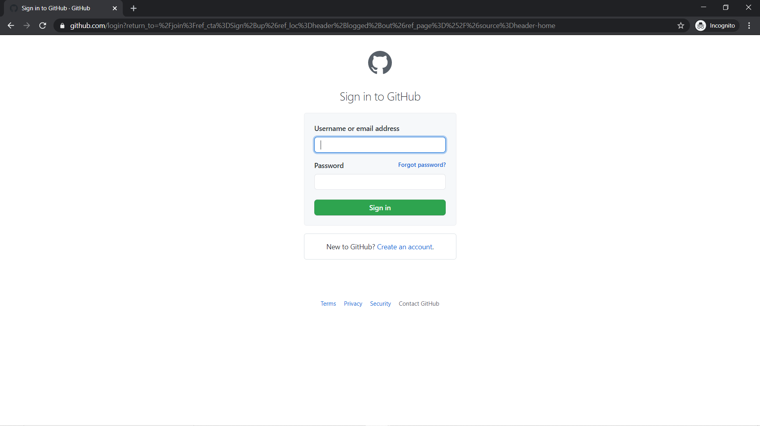
Github - Signin

Slide 6
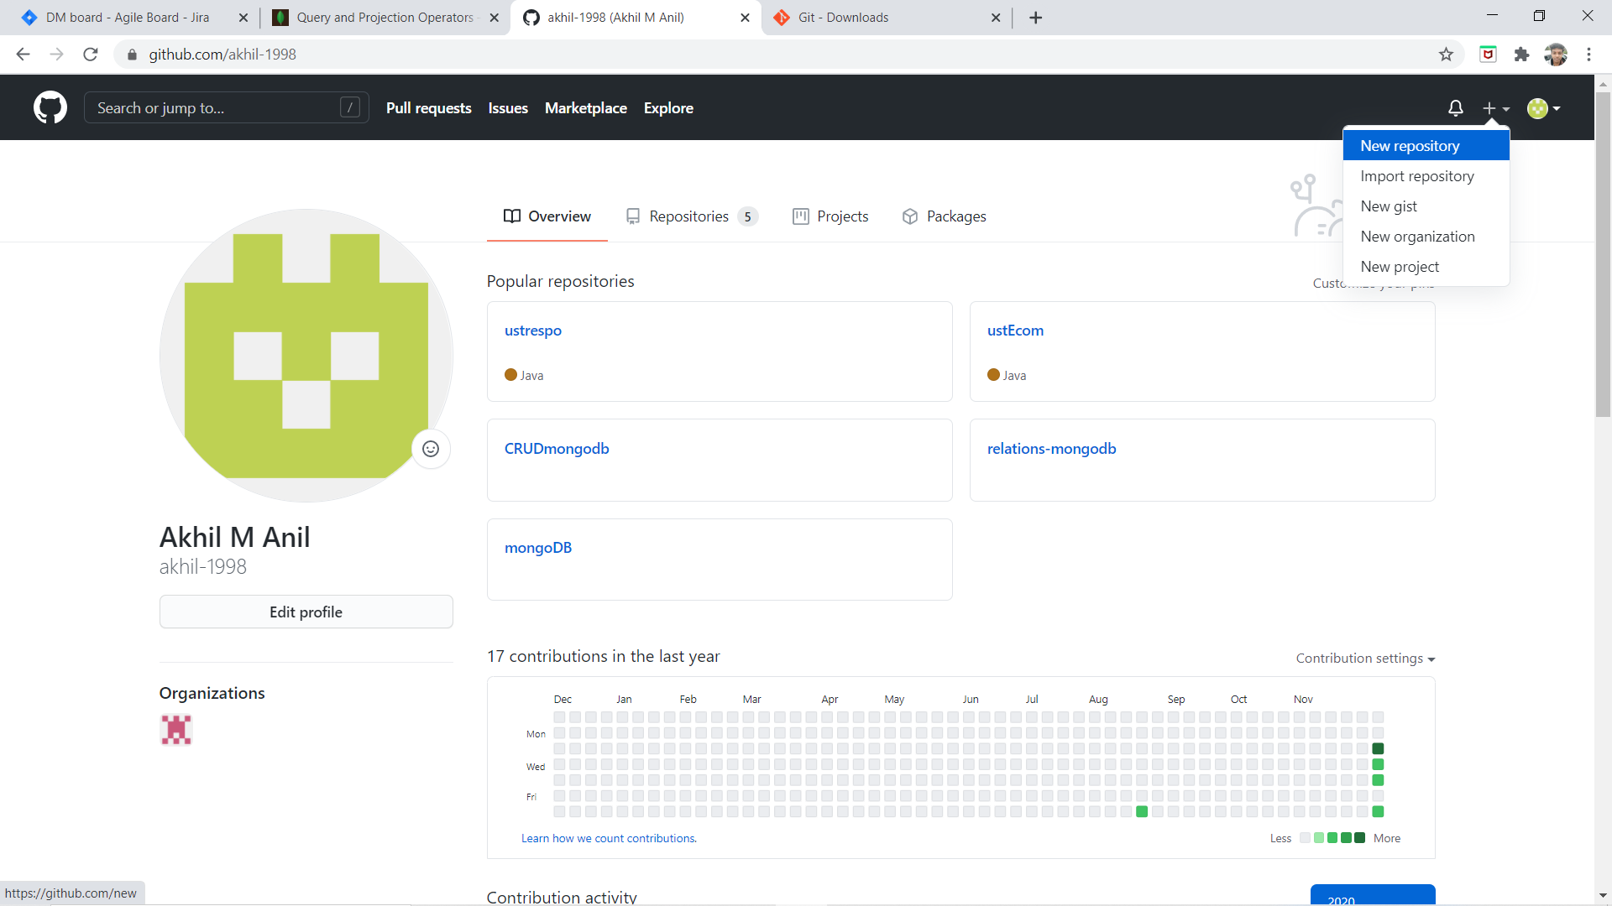
Github - Profile

Slide 7
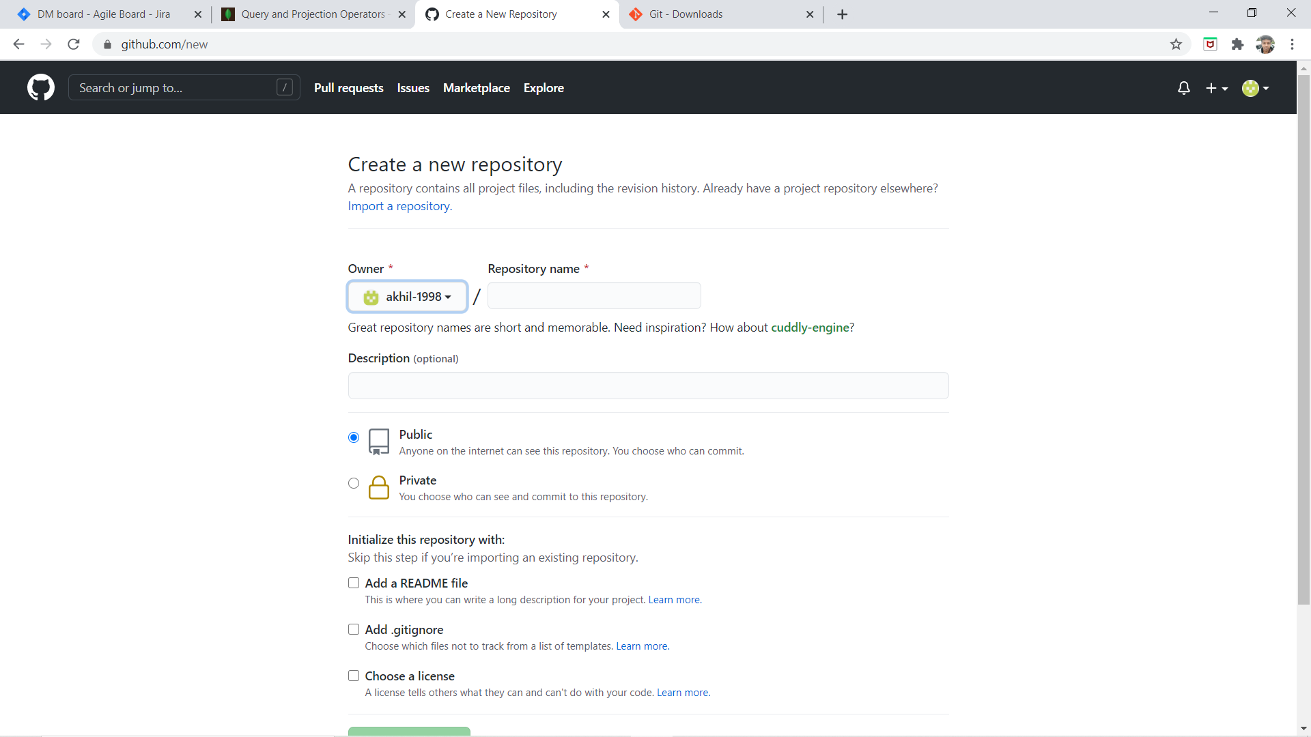
Github – Create Repository

Slide 8
Create a repo through command line
git init
git add .
git commit –m “Initial commit”
git remote add origin https://github.com/akhil-1998/mongoDB.git
git push -u origin master

Slide 9
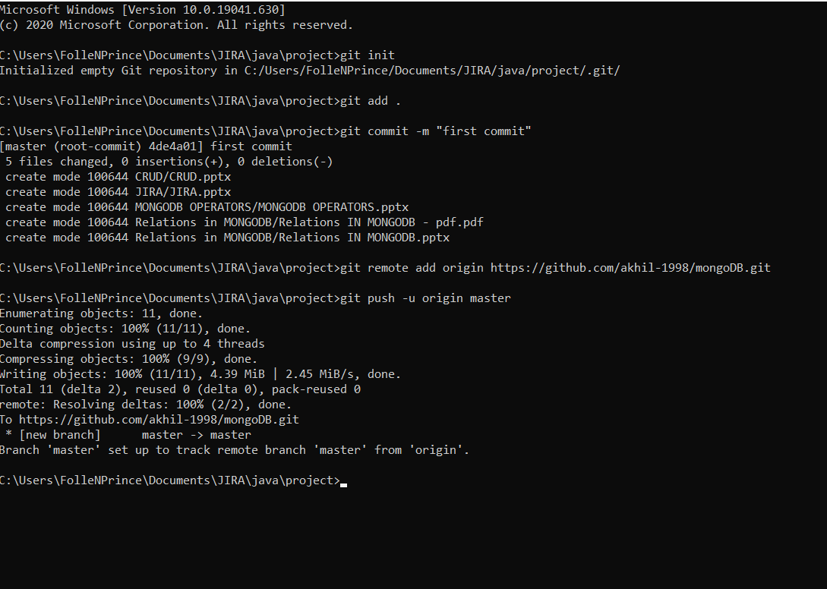
CMD

